Slide 1

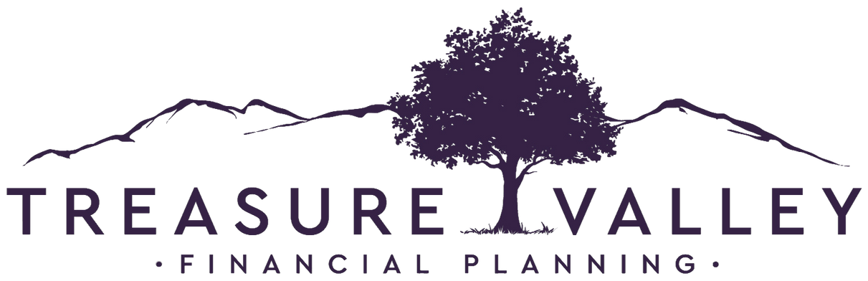
Compound Impact: The New Return on Investment

Slide 2

CORE FOCUS
Compound Our Impact by Empowering Clients to do the Same
Einstein called compound interest the eighth wonder of the world — but we believe in something even more powerful: Compound Impact™. We empower our clients to make wise financial decisions to live with purpose, create meaningful legacies, and amplify their impact on their best investments: their families, communities, and the causes they care about most.
As a fiduciary, comprehensive financial planning firm with over seventy years of combined experience, we saw an opportunity to serve the community we love by providing independent and objective financial advice. We ensure that wealth is managed not just for financial security, but for lasting significance.
We accomplish this through our Treasure Valley Family Office, a powerful network of CPAs, attorneys, and other strategic professionals working in concert to deliver advanced planning solutions, including:
Every financial decision has the power to compound over time, shaping not just your future but generations to come. As we help our clients build their legacies, Treasure Valley Financial Planning creates its own legacy of Compound Impact™ — expanding financial security, opportunity, and generosity across families and communities.
Join us in maximizing your wealth and your impact.
DYNAMIC
INVESTMENT MANAGEMENT
ADVANCED TAX
MITIGATION
EFFICIENT WEALTH
TRANSFER
STRATEGIC WEALTH
PROTECTION
MAGNIFIED CHARITABLE
GIVING
INCOME
OPTIMIZATION

Slide 3

Core Values
INTEGRITY
PROFESSIONALISM
CO-ELEVATE
HUMBLE & HUNGRY
POSITIVE MINDSET

Slide 4

Who We Serve
Successful Pre-Retiree & Retiree
  Couples
  Women making big financial decisions alone
  Business Executives
  Business owners looking to exit within 5 years
  1-10M investable assets | 3-20M Net Worth
  Lives in the Treasure Valley
  Experienced investors
  Want family office experience
  Want to compound their impact

Slide 5

We Are Different
Treasure Valley Family Office
Advanced Tax Planning
Dynamic Investment Management
A powerful network of CPA’s, attorneys, and other strategic professionals working in concert to deliver advanced planning solutions beyond investing.
Proactive tax planning combined with advanced strategies designed to reduce lifetime tax burden.
Protection first with strategic growth to dynamically shift in a complex and changing world.

Slide 6
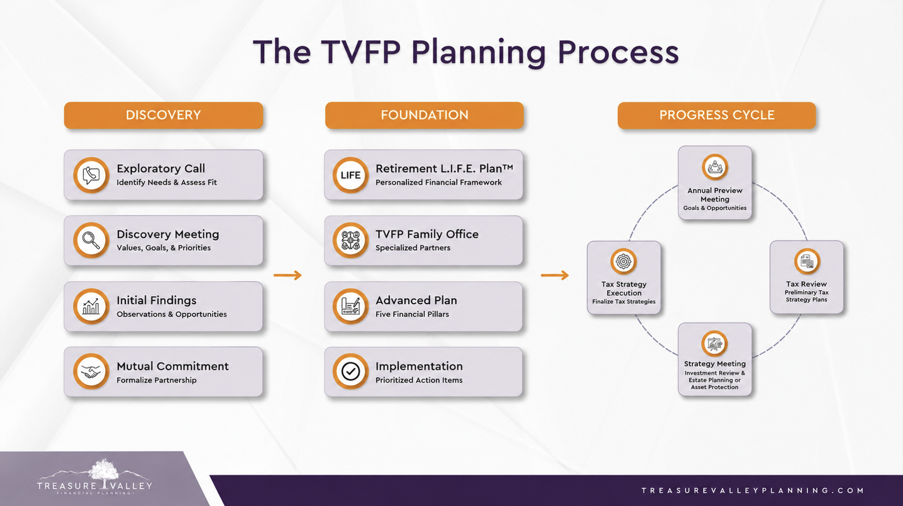

Slide 7
Income Optimization
Dynamic Investment
Management
Advanced
Plan
Magnified Charitable Giving
Efficient Wealth
Transfer
Strategic Wealth
Protection
Advanced Tax
Mitigation

Slide 8
This material is intended for educational purposes only. You should always consult a financial, tax, or legal professional familiar with your unique circumstances before making any financial decisions. Nothing in this material constitutes a solicitation for the sale or purchase of any securities. Any mentioned rates of return are historical or hypothetical in nature and are not a guarantee of future returns. Past performance does not guarantee future performance. Future returns may be lower or higher. Investments involve risk. Investment values will fluctuate with market conditions, and security positions, when sold, may be worth less or more than their original cost. Advisory Services offered through Treasure Valley Financial Planning, a Registered Investment Adviser with the SEC. Registration of an investment adviser does not imply a certain level of skill or training.

